Slide 1
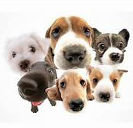
Hey, what kind of dog is that?
Keeshan Williams, PhD.

Slide 2


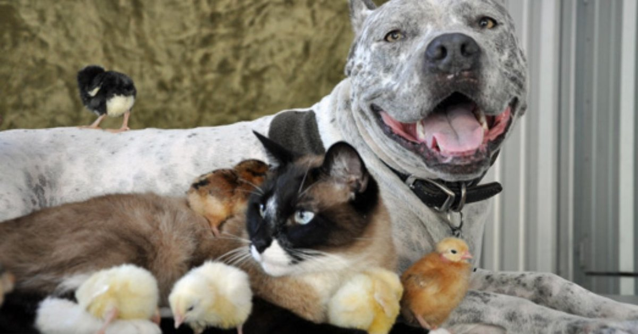
10+ years Analytical Scientist
PhD./MS: Chemical Engineering
BS.: Chemistry
Data Scientist
Lover of all creatures, big and small!

Slide 3
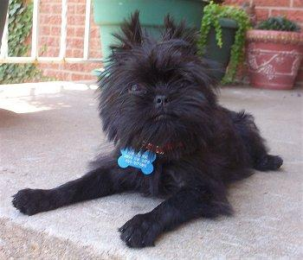
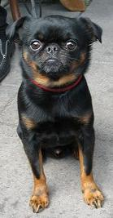
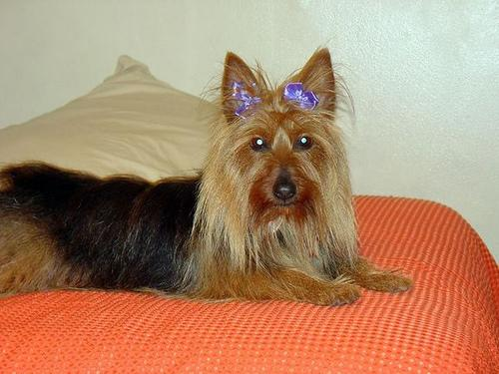
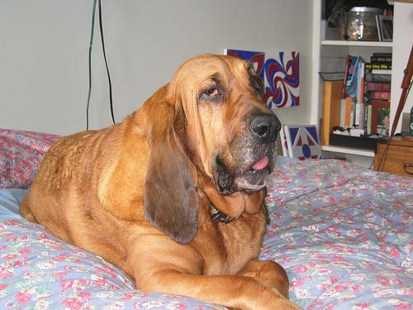
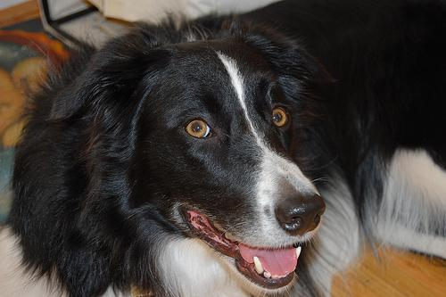
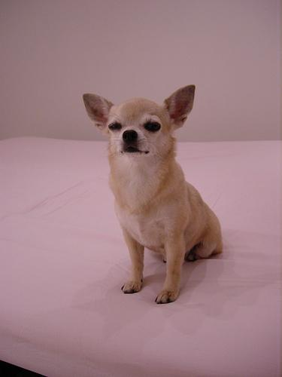
Data set
Stanford Dogs Dataset (standford.edu)
120 dog breeds
~ 150 images/class
This project:
Models based on 10 classes
Transfer learning using VVG-16 and VVG-19

Slide 4
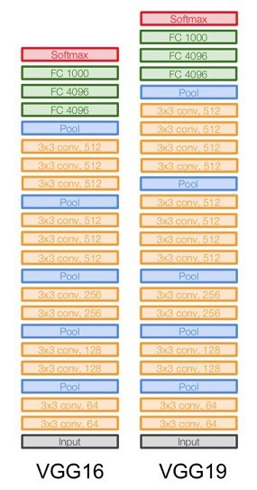
Models used
VGG-16
Convolutional neural network that is 16 layers deep
pretrained on million+ images
Froze weights on all exiting layers, except last one
Added dense layer of shape 10, with Softmax activation
Train Accuracy: 99.83%
Valid. Accuracy.: 74.10%
10 classes
100 epochs, 1173 Train, 166 Valid., 321 Test images
VGG-19
Convolutional neural network that is 18 layers deep
pretrained on million+ images
Froze weights on all exiting layers, except last one
Added dense layer of shape 10, with Softmax activation
Train Accuracy: 99.91%
Valid. Accuracy.: 77.71%
10 classes
100 epochs, 1173 Train, 166 Valid., 321 Test images

Slide 5
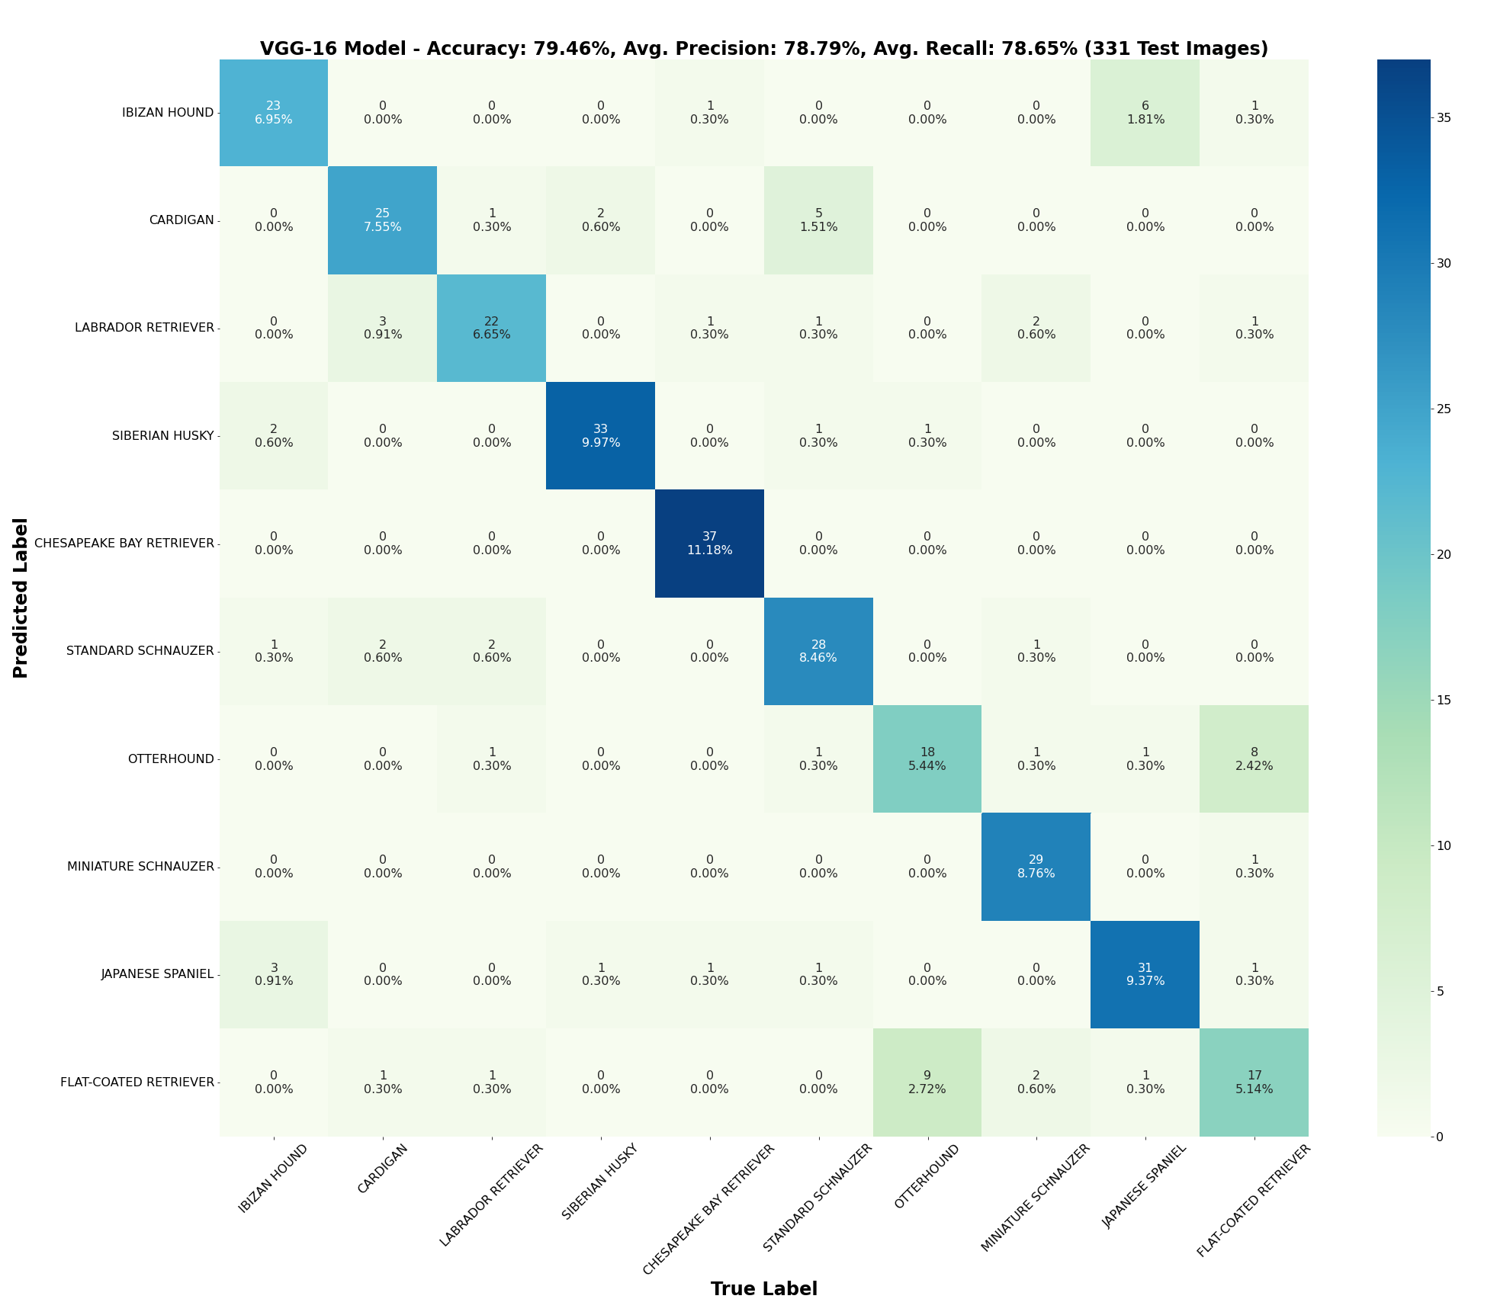

Slide 6
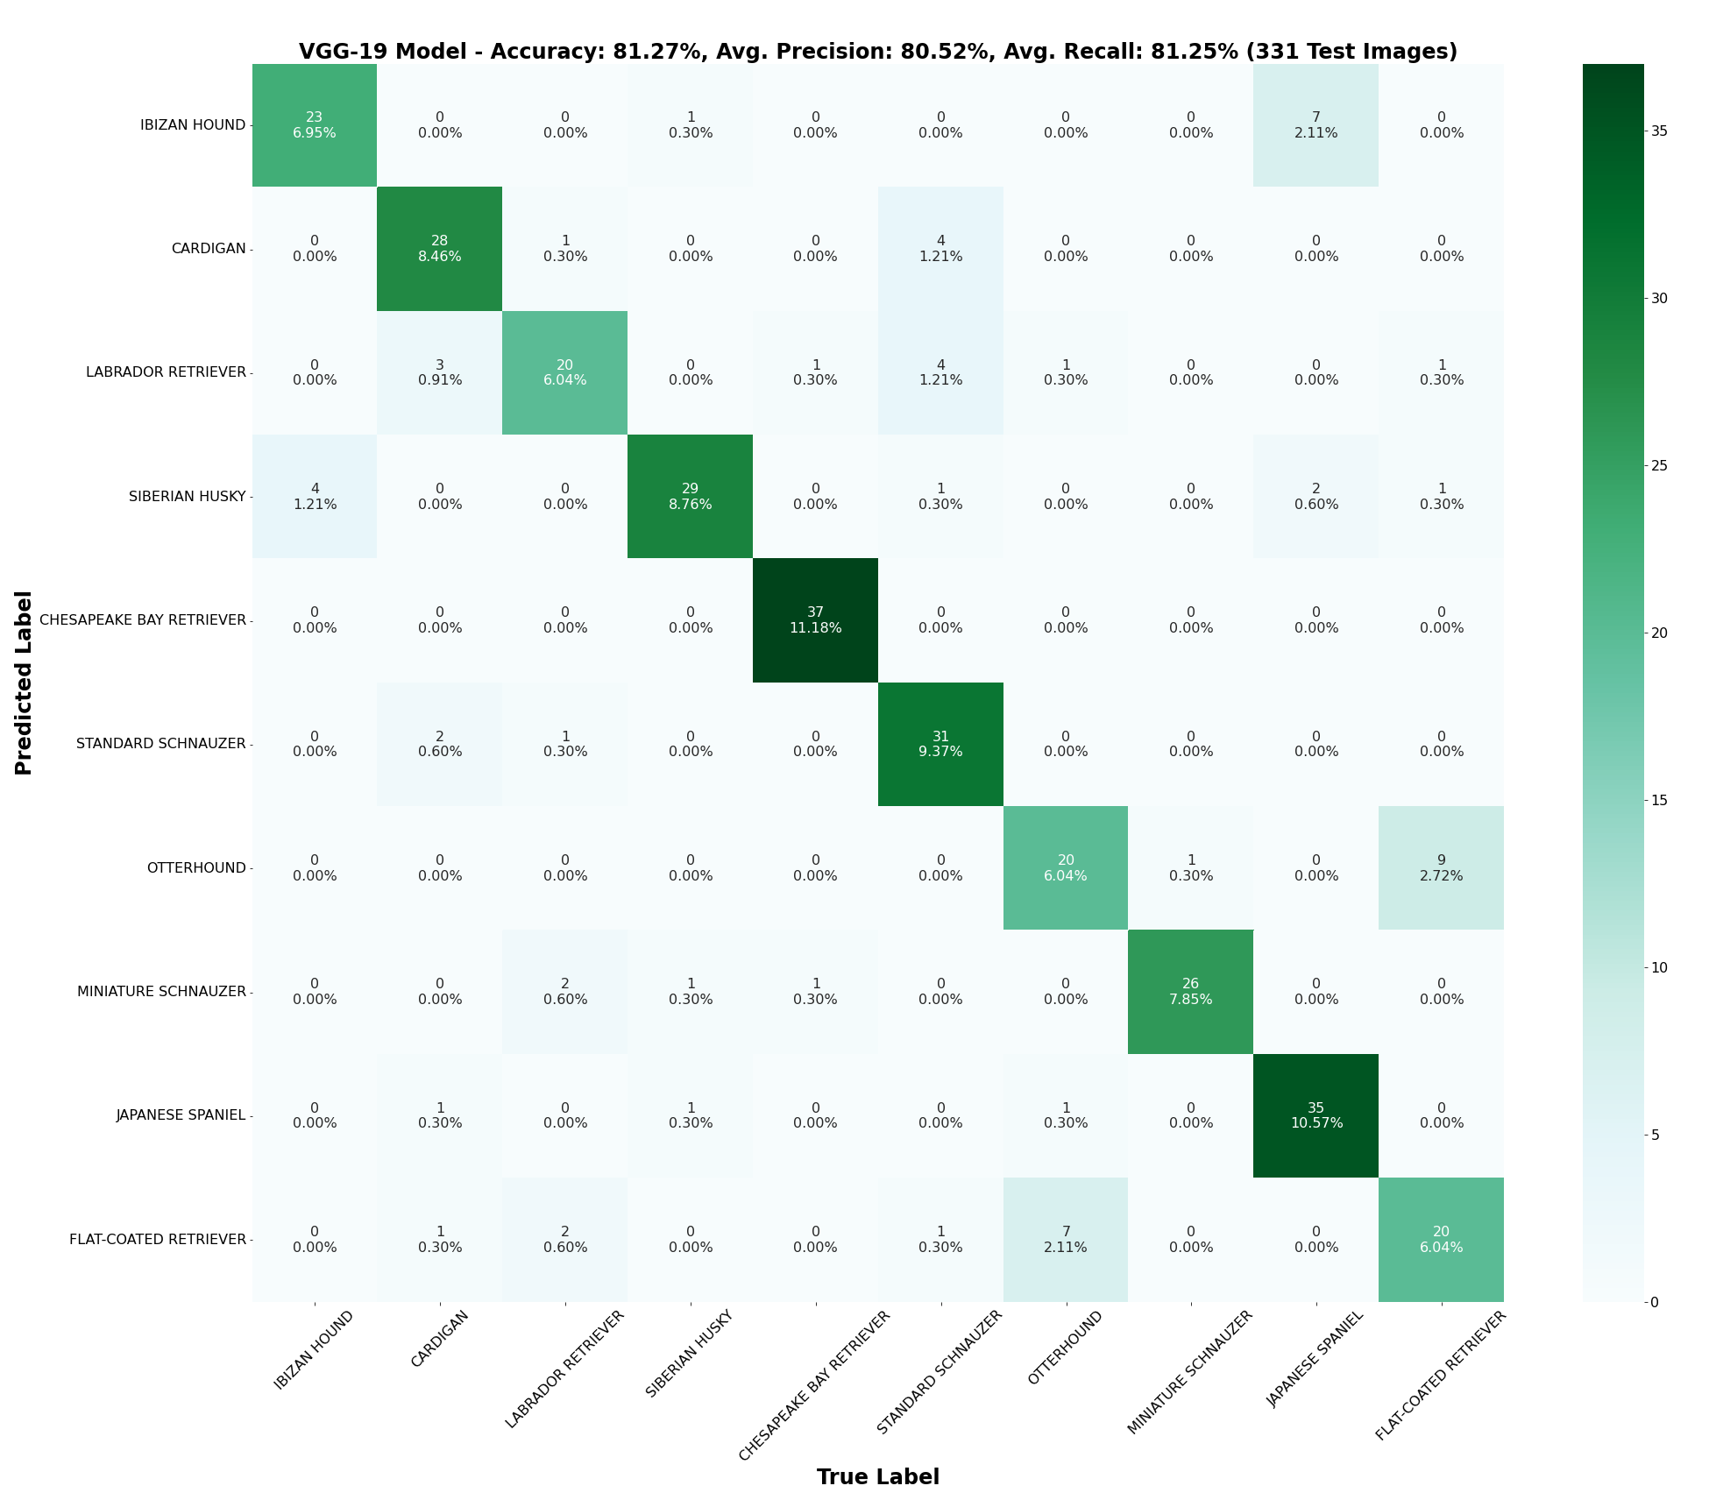

Slide 7
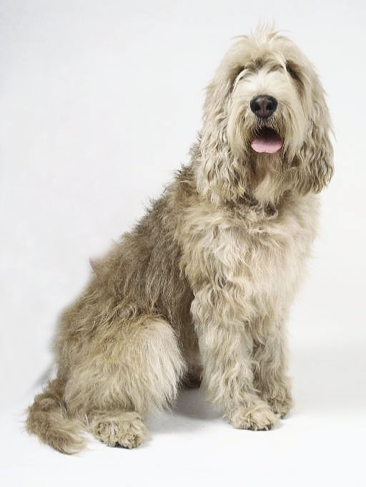
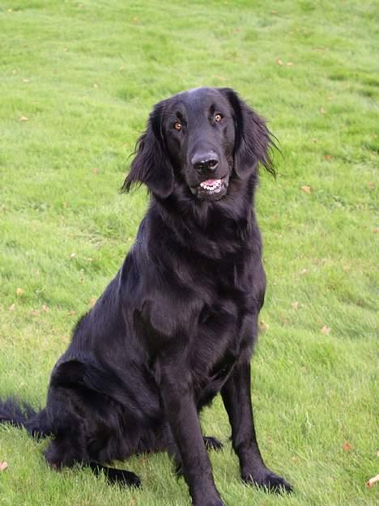
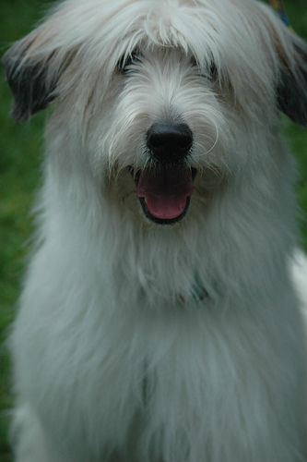
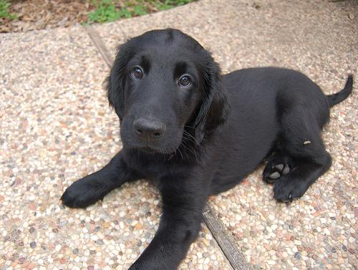
Otterhound vs. Flat-coated Retriever
≠

Slide 8
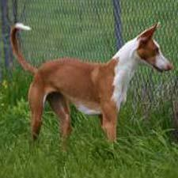
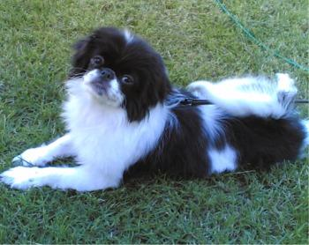
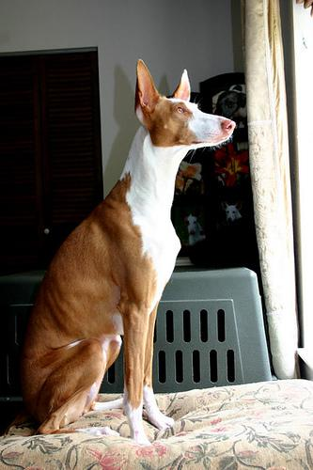
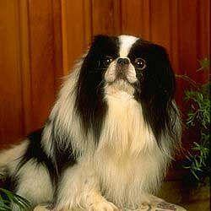
Japanese Spaniel vs. Ibizan Hound
≠

Slide 9
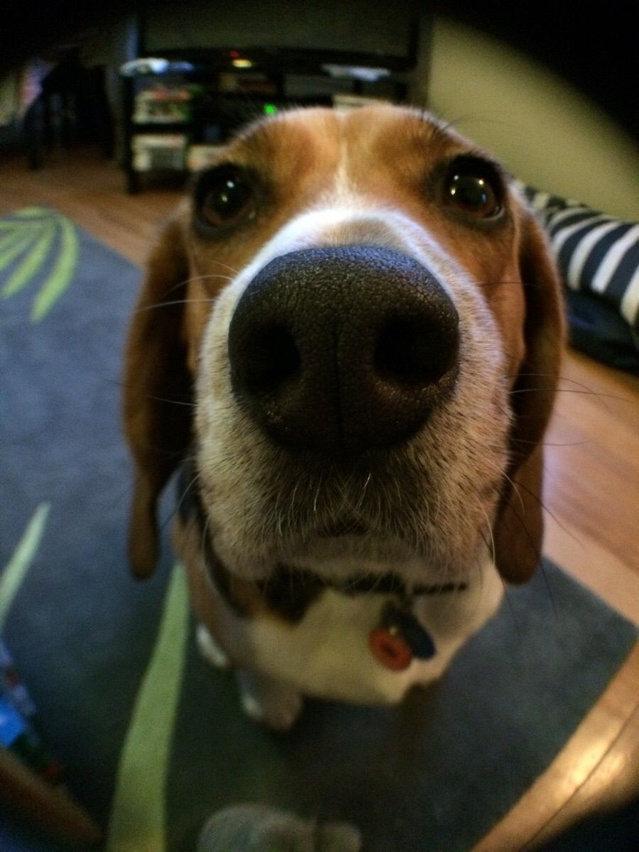
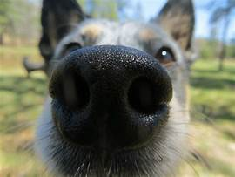
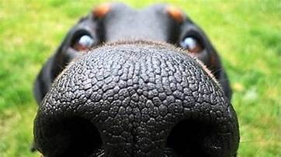
TOP DOG SHOUT OUTS!!!
Miguel
Angelis
Alexander
Martinez
Jonathan Lendof

